Slide 1
IO3 module 1
The concept and behaviour characteristic of children from vulnerable groups
Viktor Sušec, APGA
October 2021
The European Commission's support for the production of this publication does not constitute an endorsement of the contents, which reflect the views only of the authors, and the Commission cannot be held responsible for any use which may be made of the information contained therein. (Project Number: 613266-EPP-1-2019-1-EL-SPO-SCP)

Slide 2
Youth&Vulnerability
What is it
How does it affect youth
Framework

Slide 3
Youth
Definition of children and youth
World Health Organization (WHO) and United Nations Children's Fund (UNICEF) defines “adolescents” as individuals in the 10-19 years age group and “youth” as the individuals between 15-24 years of age.
Term 'Young People' covers the age range 10-24 years.

Slide 4
Vulnerability
Definitions of vulnerability
Vulnerability is a state of susceptibility to harm from exposure to stresses associated with environmental and social change and from the absence of capacity to adapt.
The intrinsic and dynamic feature of an element at risk that determines the expected damage/harm resulting from a given hazardous event and is often even affected by the harmful event itself. Vulnerability changes continuously over time and is driven by physical, social, economic, and environmental factors.
“The potential to suffer harm or loss, related to the capacity to anticipate a hazard, cope with it, resist it and recover from its impact. Both vulnerability and its antithesis, resilience, are determined by physical, environmental, social, economic, political, cultural, and institutional factors

Slide 5
Vulnerability
Definitions of vulnerability
Vulnerability is related to the characteristics and circumstances of a community or system; these characteristics and circumstances make community or system susceptible to hazard and cause loss. There are many aspects of vulnerability, arising from various physical, social, economic, and environmental factors. Examples may include poor design and construction of buildings, inadequate protection of assets, lack of public information and awareness, limited official recognition of risks and preparedness measures, and disregard for wise environmental management.
Vulnerability refers to the inability (of a system or a unit) to withstand the effects of a hostile environment
Vulnerability = (Exposure ) + (Resistance) + (Resilience)
With:
Exposure: at risk property and population
Resistance: Measures taken to prevent, avoid or reduce loss
Resilience: Ability to recover prior state or achieve desired post-disaster state

Slide 6
Vulnerability
Types of vulnerability
Economic
Physical
Social
Enviromental
Social/Human
Physical
Economic
Environmental

Slide 7
Vulnerability
Common caracteristic of vulnerabilty
Multi-dimensional
Dynamic
Scale-dependent
Case specific

Slide 8
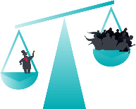
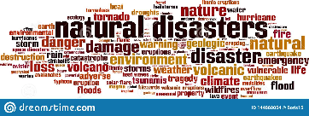
Youth&Vulnerability
Resime
Can you identify any vulnerability today’s society or individuals/groups are exposed to?
Can you identify any vulnerability youth is exposed today? Can you define context?
Economic vulnerability
The power of vulnerability
Environmental vulnerability
Social vulnerability

Slide 9
Youth&Vulnerability
Why youth/adolescence is important?
Main aspects of youth vulnerability.
Aspects of youth vulnerability:
Material - health, housing, poverty, nutrition, education
Emotional – care, love, psychosocial support
Social – supportive peer group, role models to follow, guidance, gender equality, crime

Slide 10
Youth&Vulnerability
Individual
Biological vulnerability
Intelectual vulnerability
Emotional and psychological problems
Physical disabilty
Mental disability
Family
Orphans
Chronically ill / Mentaly ill
Low oarental education
Overcrowding
Domestic violence
Parents alcohol, drugs users
Single parent
School
Absenteeism
Suspension
Poor scholastic performance
Peers
Bulying
Isolation
Deviant behavior
Society
Poverty
Iliteracy
Crime
Migration
Media exposure
Politics
Economical deprivation Sexual abuse
Material aspect
Lack of money
Lack of food
Absence of shelter/home
Iliteracy
Lack of health care
Emotional aspect
Lack of love
Lack of care and support
Absence of space
Lack of person to communicate
Poor self-esteem
Depression
Social aspect
Lack of supportive peer group
Lack of role models to folow
Misguidance in difficult situation
Risky enviroment

Slide 11
Youth&Vulnerability
Resime:
What is special about youth vulnerability?
What kind of vulnerabilities are characteristic for youth?
What impacts youth vulnerability?

Slide 12
Prevalent causes for youth vulnerabilities
Poverty
Cultur&Ethnicity
Immigrants/Refugies
Social determinants
Health
Education
Equitiy

Slide 13
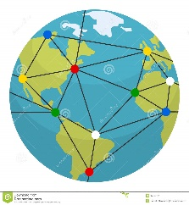
Causes for youth vulnerabilities
Poverty
Absolute poverty remains one of the gravest threats to young people in low-and middle-income countries
It also affects significant numbers of youth in high-income countries.
Problem of globalization

Slide 14
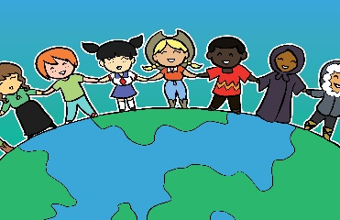
Causes for youth vulnerabilities
Culture&Ethnicity
Cultural devaluation of groups and categories of people in a society by virtue of who they are, or rather, who they are perceived to be, associated with ethnicity, caste, language, religion, gender, can even be primary cause of vulnerability and disadvantage.
Cultural diversity

Slide 15
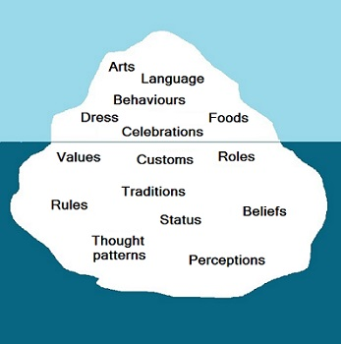
Causes for youth vulnerabilities
Imigrants/Refugies
Children with an immigrant background are a large and growing group across OECD countries, presenting specific group of vulnerable youth.
Especially vulnerable are unaccompanied minors whos' number is also rising over recent years, including in Austria, Germany, Italy Sweden

Slide 16
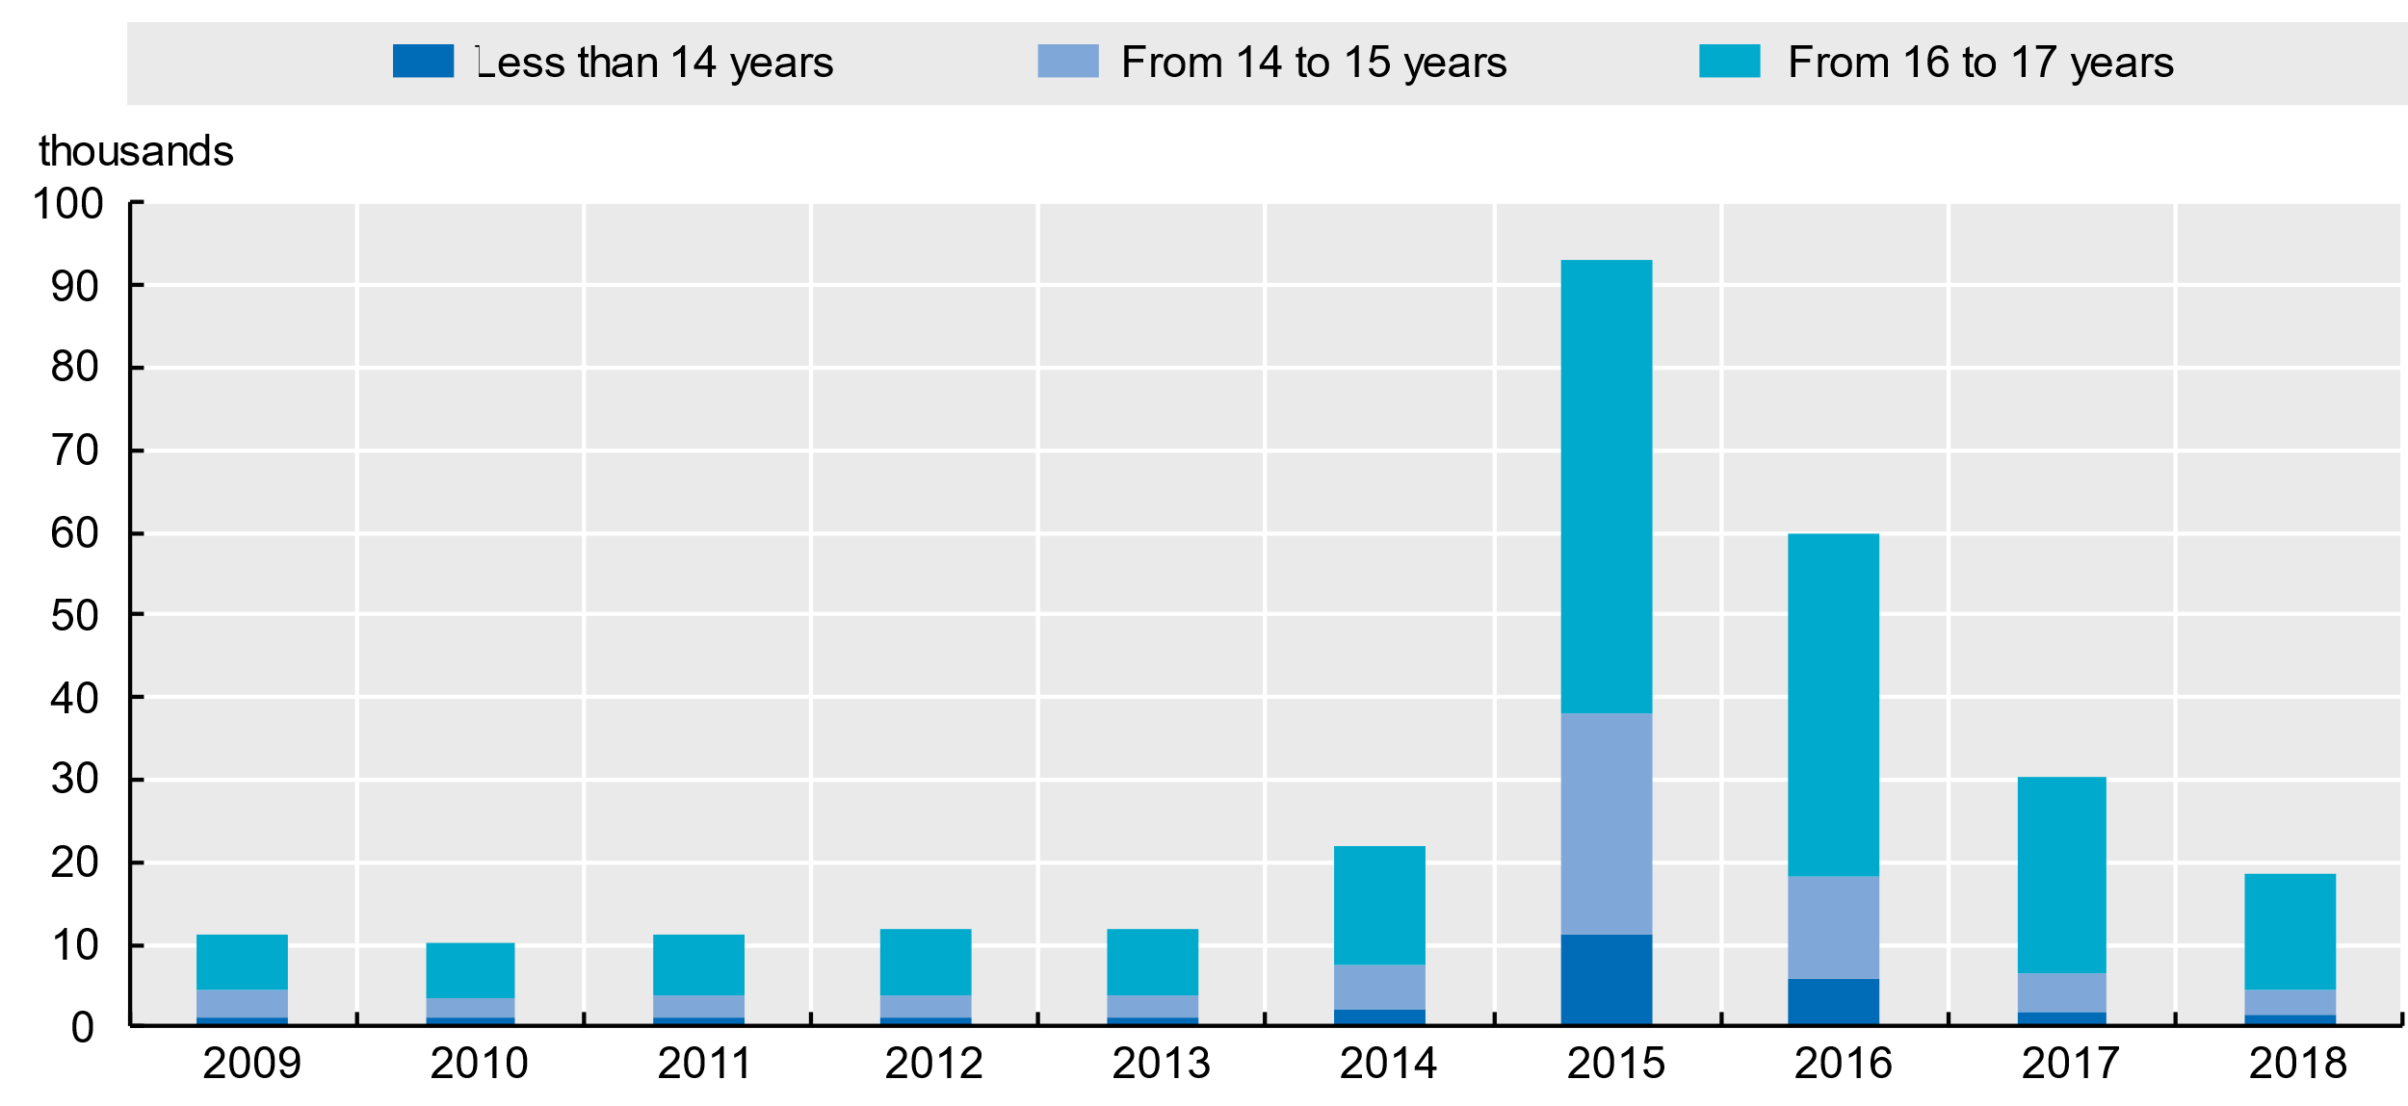
Causes for youth vulnerabilities
Asylum applications submitted by unaccompanied minors in European OECD countries

Slide 17
Causes for youth vulnerabilities
Social determinants:
Health disabilities:
Physical
Psychological
Social
Education
Equtiy
Persons with poor social determinanats are more likely to experience adverse socioeconomic outcomes such as less education, poorer health outcomes, lower levels of employment, and higher poverty rates.

Slide 18
Causes for youth vulnerabilities
Social determinants
Education
There are especially great differences in educational possibilities among developed and undeveloped countries regarding development of educational system in general.
Low educational achievement, poor quality of education and early departure from school are generally significant obstacles to good employment, effective citizenship, and many other life skills.
Youth development experts believe that youth who have no access or leave the education system early become disconnected from society, losing a chance for economic productivity and normal social integration and prosperity.
Percentage of children with a special educational need in the EU

Slide 19
Causes for youth vulnerabilities
Social determinants
Education
Changes in the percentage of students with an immigrant background between 2003 and 2015

Slide 20
Causes for youth vulnerabilities
Social determinants
Equity
Unequal distribution and access to resources (or even denial of human rights) can lead to conflicts and discontent, causing vulnerability and unequal opportunities for adolescent development.
There is much evidence that adolescents and youth who are disconnected from mainstream institutions and opportunities are likely suffer significant, often long-term, negative effects as they enter adulthood.

Slide 21
Causes for youth vulnerabilities
Resime
What vulnerabilities are most common to youth?
Define vulnerable groups among youth?
What are differences/commonalities between developed and undeveloped countries?
Find and shortly describe any policy or strategy across globe dealing with vulnerable youth

Slide 22
Working with vulnerable youth
Schools play a key role in supporting children’s social and emotional well-being and identifying and assisting children who need support.
Building teacher capacity to detect and support individual students’ needs, particularly in diverse classroom settings, can help tackling the issue.
Some basic knowledges teacher dealing with vulnerable youth should be aware about:
Signs of vulnerability
Social skills

Slide 23
Working with vulnerable youth
Signs of vulnerability
Extreme personality change
Aggressive behaviour
Anti-social behaviour
Depression
Anxiety
Difficulties at school, often displayed through truancy, or attention difficulties
Lacking friends from the same age group
Self-harm
Sudden changes in behaviour, with the child presenting in a way that is out of character (e.g. being withdrawn)
Eating/sleeping disorders, as well as suffering with nightmares
Regressing behaviour
Outbursts of crying
Becoming fidgety when previously calm and relaxed
Becoming extremely introverted when previously happy to engage
Some children become overly sociable with the strangers, and extremely unaware of boundaries.

Slide 24
Working with vulnerable youth
Social – Communication skills
Empathy
Honesty/Fairnes
Listening
Nonverbal communication
Communicating in difficult situations

Slide 25
Working with vulnerable youth
Resime
Why social skills, especially communication, are important when working with vulnerable groups?
Make an example of communication in difficult situation!

Slide 26
Conclusion
Good deal of vulnerability emerges from the way in which groups of people are treated by the rest of society.
Vulnerability can’t be boxed and defined as it depends on specific situation when considering environmental vulnerability and relations in society when considering socioeconomic vulnerability.
Vulnerability is also not expressed only in poorer or less developed environments but is present in all micro and macro social environments, family, school, community, etc.
PE teachers and sport coaches have great responsibility to young people, recognizing their trouble, and important role in taking the right action enabling their social inclusion, and equal opportunity.

Slide 27
Thank you
The European Commission's support for the production of this publication does not constitute an endorsement of the contents, which reflect the views only of the authors, and the Commission cannot be held responsible for any use which may be made of the information contained therein. (Project Number: 613266-EPP-1-2019-1-EL-SPO-SCP)

